Slide 1

Introduction to Six Sigma

Slide 2
WHAT IS SIX SIGMA?
Six Sigma is a method that provides organizations tools to improve the capability of their business processes.
Six Sigma quality is a term generally used to indicate a process is well controlled (within process limits ±3s from the centre line in a control chart, and requirements/tolerance limits ±6s from the centre line).

Slide 3
Different definitions for Six Sigma share some common threads:
Use of teams that are assigned well-defined projects that have direct impact on the organization's bottom line.
Emphasis on the DMAIC approach to problem solving: define, measure, analyse, improve, and control.
A management environment that supports these initiatives as a business strategy.

Slide 4
Differing opinions on the definition of Six Sigma
Set of tools— The Six Sigma expert uses qualitative and quantitative techniques to drive process improvement. A few such tools include statistical process control (SPC), control charts, failure mode and effects analysis, and process mapping. Six Sigma professionals do not totally agree as to exactly which tools constitute the set.
Methodology— This view of Six Sigma recognizes the underlying and rigorous approach known as DMAIC (define, measure, analyse, improve and control). DMAIC defines the steps a Six Sigma practitioner is expected to follow, starting with identifying the problem and ending with the implementation of long-lasting solutions. While DMAIC is not the only Six Sigma methodology in use, it is certainly the most widely adopted and recognized.
Metrics – In simple terms, Six Sigma quality performance means 3.4 defects per million opportunities (accounting for a 1.5-sigma shift in the mean).

Slide 5
The Difference between Six Sigma and Lean Six Sigma
Comparing Six Sigma and Lean. Essentially, Six Sigma and Lean systems have the same goal.
Lean practitioners believe that waste comes from unnecessary steps in the production process that do not add value to the finished product, while Six Sigma proponents assert that waste results from variation within the process.

Slide 6
History of Six Sigma
The Six Sigma methodologies were formulated by Bill Smith at Motorola in order to arrest the quality downslide of the company in 1986.
Six Sigma tools are developed by taking inspiration from traditional Quality Control, TQM, and TPM etc.
Six Sigma was initially targeted to quantify the defects occurred during manufacturing processes, and to reduce those defects to a very small level.
Another very popular successful user was GE.
Today Six Sigma is delivering business excellence, higher customer satisfaction, and superior profits by dramatically improving every process in an enterprise, whether financial, operational or production.
Six Sigma has become a darling of a wide spectrum of industries, from health care to insurance to telecommunications to software.

Slide 7


Six Sigma Pioneered at Motorola & GE in the mid-1980s

Slide 8
Why is Six Sigma called Six Sigma, and not Four or Five Sigma or Eight Alpha?
Sigma is a Greek symbol represented by "σ".
Sigma is a statistical term that measures process deviation from the process mean or target.
Mean is also referred to as average in common language

Slide 9
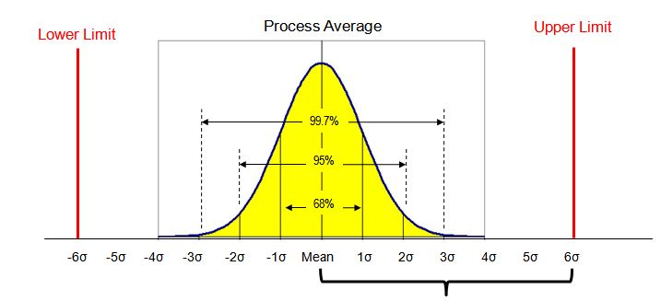
Why is Six Sigma called Six Sigma, and not Four or Five Sigma or Eight Alpha?
Look at the figure.
A normally distributed process if mean plus minus 3σ range of output is between USL and LSL then around 99.997% (or almost all) of the output will be non-defective or the process is of 6σ level.
Now, if the USL and LSL of a process are such that the difference between USL and LSL is less than 6σ value of the process, then it won’t be a Six Sigma process.
To make this process a Six Sigma process you have to reduce the values of σ.
The Six Sigma methodology broadly tells about how to reduce the value of σ and make it a six-sigma process.
DPMO (Defect Per Million Opportunities) is used for counting defects in statistical processes. A Six Sigma process will have 99.997% accuracy or 3.4 DPMO which is extremely accurate.

Slide 10
SIX SIGMA
Six Sigma is a systematic and data driven approach to improve process capability.
Accuracy level of a six sigma process is 3.4 DPMO or 99.997% which is fairly accurate.
Most of the pioneer organizations of Six Sigma users found that up to the sigma level of six is right trade off between cost and quality however running a process in five sigma or seven sigma is individual organizations personal call on the basis of required accuracy and cost.

Slide 11
How does 6 Sigma work?
The driving force behind any Six Sigma project comes from its primary focus - "bringing breakthrough improvements in a systematic manner by managing variation and reducing defects".
This requires us to ask tougher questions, raise the bar significantly, and force people to think out of the box and to be innovative.
The objective is to stretch, and stretch mentally not physically.
To make this journey successful there is a methodology(s) to support Six Sigma implementations.
There are two potential scenarios –
First, there is already an existing process(s) that is working "reasonably" well; and second there is no process at all.
A bad process is as good as no process.
The first scenario focuses on significant process improvements and requires use of DMAIC.
The second scenario focuses on process design using Design For Six Sigma (DFSS) approach. DFSS typically requires IDOV.

Slide 12
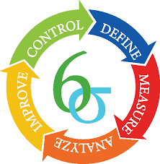
DMAIC

Slide 13
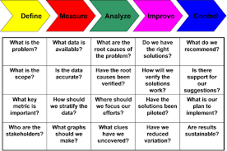
DMAIC

Slide 14
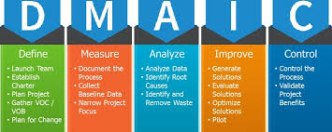

Slide 15
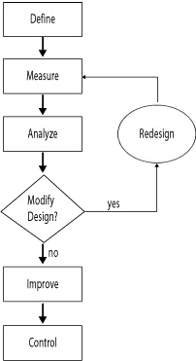
DMAIC

Slide 16
DMAIC
DMAIC is a data-driven quality strategy used to improve processes.
It is an integral part of a Six Sigma initiative, but in general can be implemented as a standalone quality improvement procedure or as part of other process improvement initiatives such as lean.

Slide 17
DMAIC is an acronym for the five phases that make up the process
Define the problem, improvement activity, opportunity for improvement, the project goals, and customer (internal and external) requirements.
Measure process performance.
Analyze the process to determine root causes of variation, poor performance (defects).
Improve process performance by addressing and eliminating the root causes.
Control the improved process and future process performance.

Slide 18
1-Define
The process kicks off with a clear statement of the target business problem and the scope of the intended improvements.
The current state is documented in great detail as is the problem to be solved.
At this point, teams also determine the objectives of improvement and map out what success looks like.
Some organizations use formal project charters at the outset of a DMAIC cycle, while others are less formal.
Ample documentation and detail are essential nevertheless.

Slide 19
2-Measure
DMAIC is a data-driven approach to improvement.
That means that you need to have baseline measurements that can be compared to post-improvement results.
Quantifiable process effectiveness measurements might include the number of defects, process duration, process cost, or other relevant metrics.
One or more members of the team should be assigned the responsibility for measurement and the team should agree on how frequently the measurement will take place.

Slide 20
3-Analyze
Now that the team is armed with data, a root-cause analysis is performed to determine the underlying reason(s) for the business problem.
Many organizations find that the 5 Whys technique is a helpful way to structure the process.
Process maps are also popular.
It is important to remember that many problems have more than one root-cause.
Keeping attention on the causes, not the symptoms, helps make solutions more apparent and reduces the tendency to become defensive or to blame people, rather than processes.

Slide 21
Determine the Root Cause: 5 Whys
When Is 5 Whys Most Useful
When problems involve human factors or interactions.
In day-to-day business life; can be used within or without a Six Sigma project.
How to Complete the 5 Whys
1-Write down the specific problem. Writing the issue helps you formalize the problem and describe it completely. It also helps a team focus on the same problem.
2-Ask Why the problem happens and write the answer down below the problem.
3-If the answer you just provided doesn’t identify the root cause of the problem that you wrote down in Step 1, ask Why again and write that answer down.
4-Loop back to step 3 until the team is in agreement that the problem’s root cause is identified. Again, this may take fewer or more times than five Whys.

Slide 22
4-Improve
It is essential to fight the urge to leap to the Improve stage.
Proposed improvements should be implemented only after careful measurement and thoughtful analysis.
There is an element of experimentation in DMAIC, but it should be tempered with good data and sound logic.
Any risks associated with the improvement should be identified and communicated, along with the steps taken to mitigate those risks.
Everyone should be on the lookout for unintended consequences so that action can be taken swiftly.

Slide 23
5-Control
The final step in a DMAIC cycle is Control.
It is an essential piece of the equation that is often missing when improvement work occurs without structure.
Control is about making sure that successful improvements don’t degrade over time.
At this point teams, verify measurable improvement and determine if the improvements as implemented have achieved the project goals.
They also update Standard Work documentation and look for other ways to integrate the lessons that have been learned.

Slide 24
How is DMAIC deployed?
There are two approaches to implementing DMAIC:-
The first is the team approach in which individuals who are skilled in the tools and method, such as quality or process improvement experts, lead a team.
The team members work on the project part-time while caring for their everyday responsibilities.
The quality or process improvement expert might be assigned to several projects. These are long-duration projects taking months to complete.

Slide 25
How is DMAIC deployed?
The second tactic involves the kaizen event method, an intense progression through the DMAIC process typically done in about a week.
Prep work is completed by the quality or process improvement expert, and is cantered on the define and measure phases.
The rest of the phases are done by a team of individuals who have been pulled from their regular duties for the duration of the kaizen event.
In most cases, the changes are piloted during the event, and full-scale implementation is completed after the event.
It is crucial the impact of these changes—whether they are wanted or not—are monitored.
The advantage of this approach is the ability to make rapid change.

Slide 26
When Should DMAIC be Used?
When improving a current process, if the problem is complex or the risks are high, DMAIC should be the go-to method.
Its discipline discourages a team from skipping crucial steps and increases the chances of a successful project, making DMAIC a process most projects should follow.
If the risks are low and there is an obvious solution, some of the DMAIC steps could be skipped, but only if:
Trustworthy data show this is the best solution for your problem.
Possible unintended outcomes have been identified and mitigation plans have been developed.
There is buy-in from the process owner.
If the obvious solution can’t be proven with trustworthy data, a DMAIC project should be launched.

Slide 27
Tools are Used for DMAIC
D-Define Phase
Tools Used
Define Customers and Requirements (CTQs)
Develop Problem Statement, Goals and Benefits
Identify Champion, Process Owner and Team
Define Resources
Evaluate Key Organizational Support
Develop Project Plan and Milestones
Develop High Level Process Map
Project Charter
Process Flowchart
SIPOC Diagram
Stakeholder Analysis
DMAIC Work Breakdown Structure
CTQ Definitions
Voice of the Customer Gathering

Slide 28
Tools are Used for DMAIC
M – Measure Phase
Tools Used
Define Defect, Opportunity, Unit and Metrics
Detailed Process Map of Appropriate Areas
Develop Data Collection Plan
Validate the Measurement System
Collect the Data
Begin Developing Y=f(x) Relationship
Determine Process Capability and Sigma Baseline
Process Flowchart
Data Collection
Plan/Example
Benchmarking
Measurement System Analysis/Gage R&R
Voice of the Customer Gathering
Process Sigma Calculation

Slide 29
Tools are Used for DMAIC
A – Analyze Phase:
Tools Used
Define Performance Objectives
Identify Value/Non-Value Added Process Steps
Identify Sources of Variation
Determine Root Cause(s)
Determine Vital Few x’s, Y=f(x) Relationship
Histogram
Pareto Chart
Time Series/Run Chart
Scatter Plot
Regression Analysis
Cause and Effect/Fishbone Diagram
5 Whys
Process Map Review and Analysis
Statistical Analysis
Hypothesis Testing(Continuous and Discrete)
Non-Normal Data Analysis

Slide 30
Tools are Used for DMAIC
I – Improve Phase
Tools Used
Perform Design of Experiments
Develop Potential Solutions
Define Operating Tolerances of Potential System
Assess Failure Modes of Potential Solutions
Validate Potential Improvement by Pilot Studies
Correct/Re-Evaluate Potential Solution
Brainstorming
Mistake Proofing
Design of Experiments
Pugh Matrix
QFD/House of Quality
Failure Modes and Effects Analysis (FMEA)
Simulation Software

Slide 31
Tools are Used for DMAIC
C – Control Phase:
Tools Used
Define and Validate Monitoring and Control System
Develop Standards and Procedures
Implement Statistical Process Control
Determine Process Capability
Develop Transfer Plan, Handoff to Process Owner
Verify Benefits, Cost Savings/Avoidance, Profit Growth
Close Project, Finalize Documentation
Communicate to Business, Celebrate
Process Sigma Calculation
Control Charts(Variable and Attribute)
Cost Savings Calculations
Control Plan

Slide 32
Design For Six Sigma (DFSS) Approach
The second focuses on process design using Design For Six Sigma (DFSS) approach. DFSS typically requires IDOV:
Identify process goals in terms of critical parameters, industry & competitor benchmarks
Design involves enumeration of potential solutions and selection of the best
Optimize performance by using advanced statistical modeling and simulation techniques and design refinements
Validate that design works in accordance to the process goals

Slide 33
Design For Six Sigma (DFSS) Approach
Sometimes a DMAIC project may turn into a DFSS project because the process in question requires complete re-design to bring about the desired degree of improvement.
Such a discovery usually occurs during improvement phase of DMAIC.

Slide 34
Six Sigma
It is extremely important to remember that Six Sigma is not just about product quality where only three products in a million are defective.
It is about what is important or critical to the customer, whether internal or external.
It is focuses on value in context of the customer and the market.

Slide 35
Steps to Six Sigma Implementation
Create a Burning Platform
Put Resources in Place
Teach the Methodology
Prioritize Activities
Establish Ownership
Take the Right Measurements
Govern the Program
Recognize Contributions

Slide 36
References
http://asq.org/learn-about-quality/six-sigma/overview/overview.html
http://www.discover6sigma.org/post/2005/10/introduction-to-six-sigma/
https://www.brighthubpm.com/six-sigma/34950-why-six-sigma-and-not-seven-or-five-sigma/#imgn_0
http://asq.org/learn-about-quality/six-sigma/overview/dmaic.html
https://blog.kainexus.com/improvement-disciplines/six-sigma/dmaic/the-complete-beginners-guide-to-dmaic
https://www.isixsigma.com/tools-templates/cause-effect/determine-root-cause-5-whys/

Slide 37
References
https://www.isixsigma.com/implementation/success-factors/8-steps-successful-lean-six-sigma-implementation/
https://www.isixsigma.com/new-to-six-sigma/dmaic/six-sigma-dmaic-roadmap/
http://asq.org/quality-progress/2012/11/back-to-basics/to-dmaic-or-not-to-dmaic.html

